Slide 1

Java + Mobile course by Enered

Slide 2
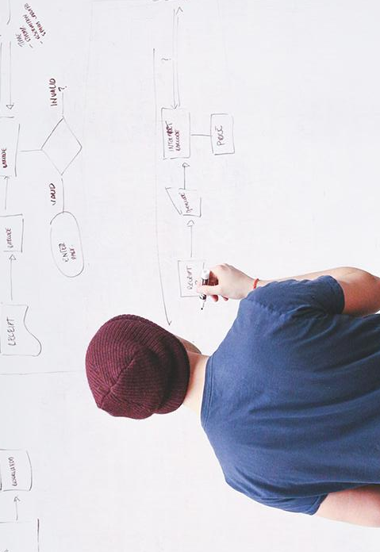
HELLO!
I am Vlad Butnaru
I will be your trainer for this Java session!
PS: It’ll be awesome!

Slide 3
You are HERE
Primitive si structuri repetitive + conditionale
OOP – Clase, obiecte, metode, constructori
UI - SWING

Slide 4
What will we do today
Final variables
Static variables
Abstract classes
Any questions?
Netbeans Hands-On

Slide 5
1. Final variables
Are constant
Their values CANNOT be changed during program execution
final int pi = 3.14;

Slide 6
2. Static variables
They don’t reinitialize when you instantiate a class;
They are Class-Specific rather than Instance-Specific
Useful for SINGLETON pattern (DEMO)
Also useful for COUNTING class instances (monitoring)
static Connection c = null;

Slide 7
3. Abstract classes
They were marked deprecated with Java 8
Are just like interfaces, but can contain variables and method implementations
Their use is not recommended and they are very memory consuming

Slide 8
4. Any questions?
Regarding the OOP part?
What is inheritance?
What is an interface
Can a class extend multiple classes?
Can a class implement multiple interfaces?
What is the difference between OVERLOADING and OVERRIDING?

Slide 9
5. Netbeans Hands-on

Slide 10
THANKS!
Any questions?
You can find me at:
@web: http://vladbutnaru.com/
@facebook· Vladut Butnaru
@linkedin· Vlad Butnaru
@email : vlad2me@gmail.com
@phone : +40 0754 827 620

Slide 11
Feedback please!
http://bit.do/feedbackvlad

